Slide 1


152nd
SYNOD 2026
Lay delegate report
Parish of St. Barnabas

Slide 2
What is a Synod?
A Synod is a formal meeting of the Church where:
Bishops (include retirees), Priests (Clergy), Lay Representatives
meet to discuss the mission, governance, and future of the Church

Slide 3

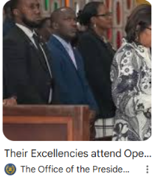
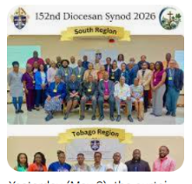
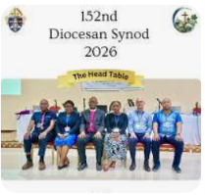
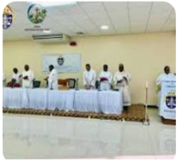
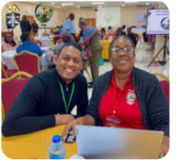
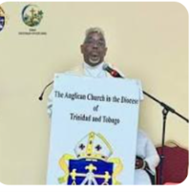

Slide 4
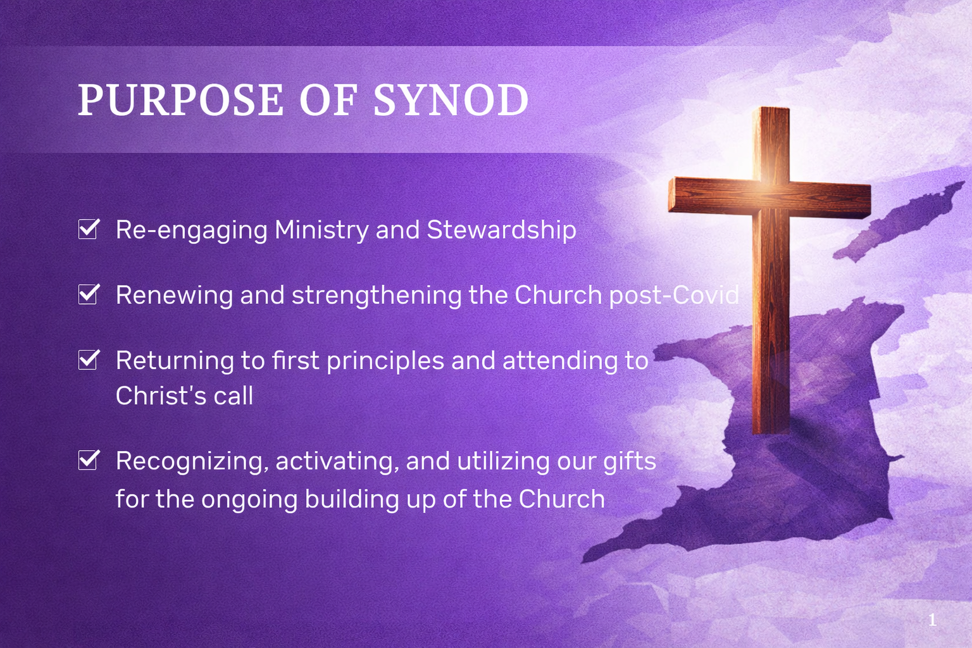

Slide 5


Slide 6
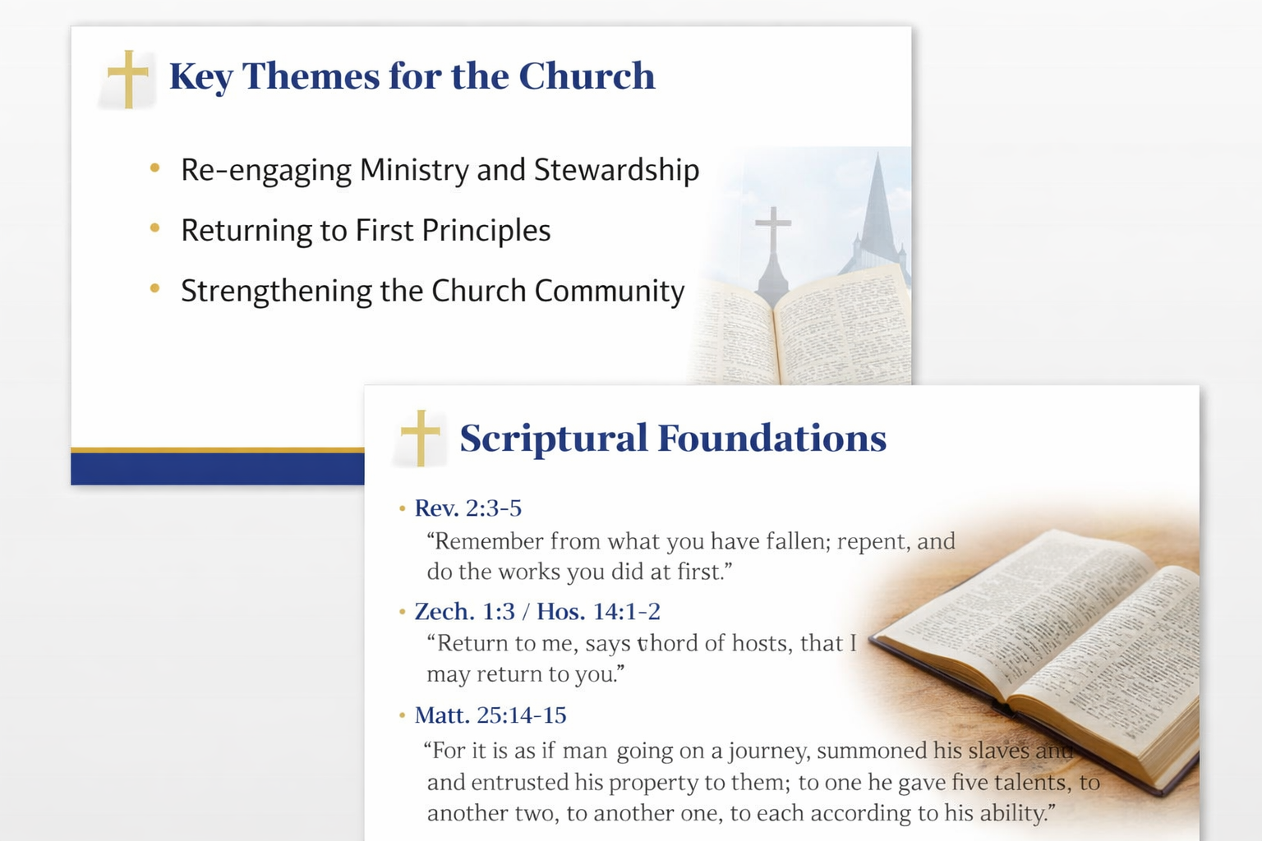

Slide 7
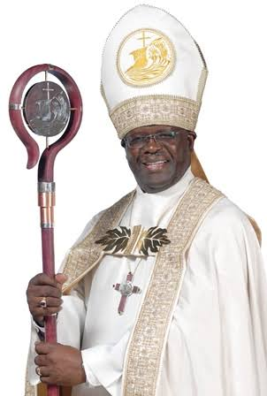
Purpose of a Synod Charge
Aims to:
Inspire spiritual growth
Review the Church's progress
Address current challenges
Present the Bishop's vision
Encourage unity and faithful service
"Let all things be done decently and in order."
— 1 Corinthians 14:40

Slide 8
Synod Charge 2026
Understanding a Synod Charge
Its Purpose, Content, and Importance in the Anglican Church
A Synod Charge is the official address delivered by the Bishop at the opening of a Synod.
It provides:
Spiritual guidance
A review of the Diocese
Direction for the future
Encouragement to Church members
A spiritual and administrative report A guiding message that sets the tone for discussions

Slide 9
Synod Charge included:
Spiritual Message
Biblical reflections
Prayer and encouragement
Church Report
Ministry updates
Financial overview
Education and outreach
Social Issues
National concerns
Community development
Justice and peace
Future Plans
Goals and priorities
Mission and evangelism

Slide 10
Summary of the main points-Core Conviction
The Church must remain present, responsive, and faithful to the local realities of the people it serves
Duty of all Christians
Importance of Ministry and Stewardship
These belong together as one integrated way of Christian living which is expressed in daily life
                .

Slide 11
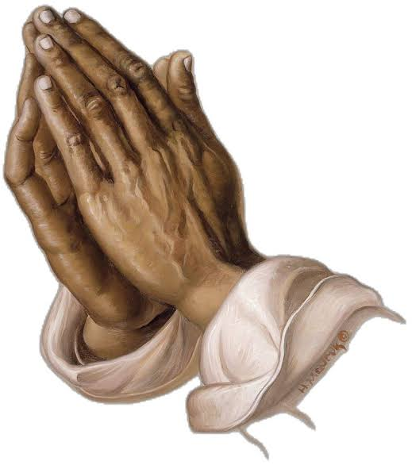
Summary of the main points-Core Conviction
Synod as Discernment, Thanksgiving and Direction

Slide 12

Being Intentional in all that you do.

Slide 13
From Discernment to Response
Strand 1: Stewardship, Discipline & Sustainability
  ( Church Systems, Resources, Integrity)
  Become more disciplined in our financial affairs
  Ensure the fiscal practice of the church are aligned with the realities of society
  Core Conviction
    Faithful stewardship ensures that what God has entrusted to the church is used wisely, so that mission is not weakened by inefficiency, neglect or fragmentation

Slide 14
From Discernment to Response
Strand 2: Formation, Discipleship & Vocation
(People, Ministry & Spiritual Depth)
“The Church must also recover confidence in its teaching ministry. In an age shaped by information overload, digital fragmentation, and competing moral narratives, the faithful require deeper grounding in Scripture, Anglican identity, doctrine, liturgy, ethics, and Christian vocation.”
Emphasis on Youth formation
Core Conviction
  The church must form disciples who are grounded, discerning and capable of faithful living in a complex and changing world.

Slide 15
From Discernment to Response
Strand 3: Stewardship, Discipline & Sustainability
  ( Church in Society & Pastoral Presence)
  Pastoral Creativity- counselling, practical assistance, community mobilization and strengthened care in a society (children & elderly) under pressure
  Core Conviction
  The church must be present, responsive, and faithful within the lived realities of the people it serves

Slide 16
📌 Key Action Agenda
Establish a Diocesan real estate company to manage property and ensure sustainability.
Resolve Bishop’s accommodation in Tobago.
Strengthen and formalize the Diocesan Archives
Creating and setting up technology for collecting offerings and donations
Develop structured Youth formation pathway.
Prioritize teaching ministry of the church (Biblical, liturgical and governance).

Slide 17
📌 Key Action Agenda
Consolidate clergy Formation
Explore responsible use of Technology in mission;
Strengthening pastoral care and ministry for the elderly,
Maintain Diocesan Assessment stability and parish compliance.
Embed safeguarding culture.
Strengthen financial discipline.
Develop data- informed and contextually responsive ministry practice
Implement training in digital tools and emerging technologies

Slide 18
Closing: Gratitude and Dependence
The Church moves from discernment into thanksgiving and faithful action.
Emphasis on Christ as the Head of the Church, we do not walk alone.

Slide 19
Business Days
Special presentations:
Ms Ena Barclay on :
“The Development of a safe church culture”.
Finance Accounting Tech- Mr. John Peter
Strategic Plan 2022-25 Fr W. Maughn
Mental Health- Wellness- Psychiatrist Dr. Othello

Slide 20
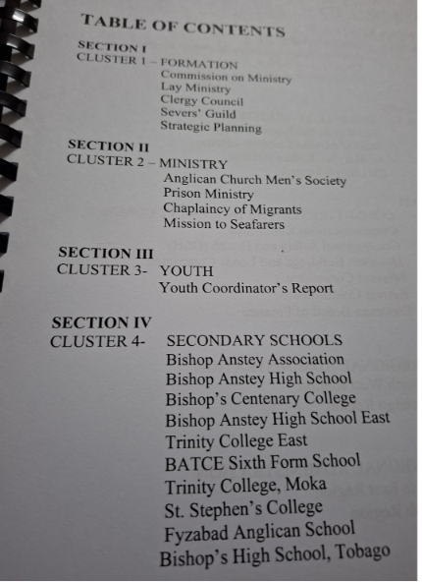
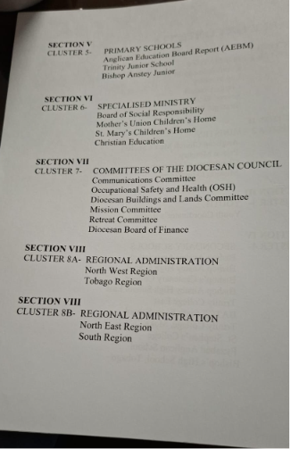
Business Days-Cluster reporting

Slide 21
Business Days- Motions & Appointments
Building & Lands Committee to revise policies
Standardization of Financial accounting and reporting
Support structure for youth and young Adult empowerment
Special remembrance for persons who were victims of Covid 19
Nomination of a Coadjutor as the Bishop is due to retire in 2029.

Slide 22
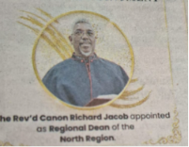
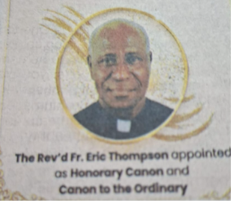
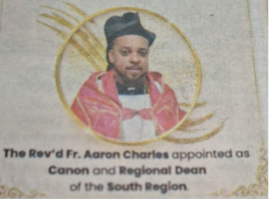
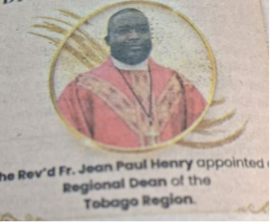
Business Days- Diocesan Appointments

Slide 23


